Slide 1
War Memorials Trust
Changes to war memorials and Remembrance

Slide 2
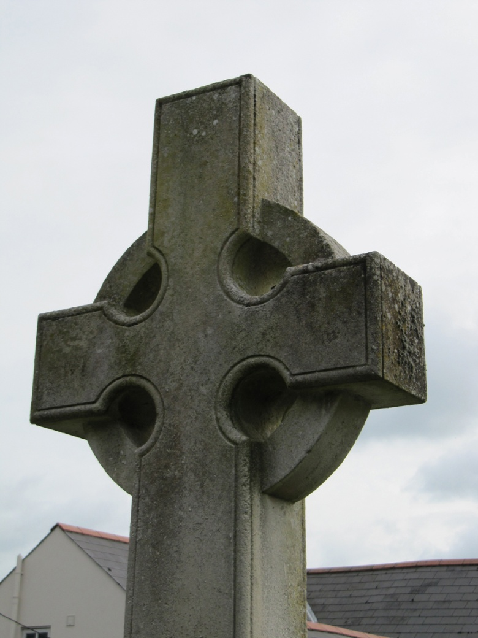
Learning objectives
Know that the function and style of war memorials has changed over time
Know how Remembrance Day traditions originated and how these have changed at key times since 1918
Niton, Isle of Wight (WM7) © Geoffrey Allan, 2011.

Slide 3
Learning outcomes
Explain some key changes to what and who war memorials commemorate
Explain how the way in which Remembrance Day is marked has changed since 1918
Niton, Isle of Wight (WM7) © Geoffrey Allan, 2011.

Slide 4
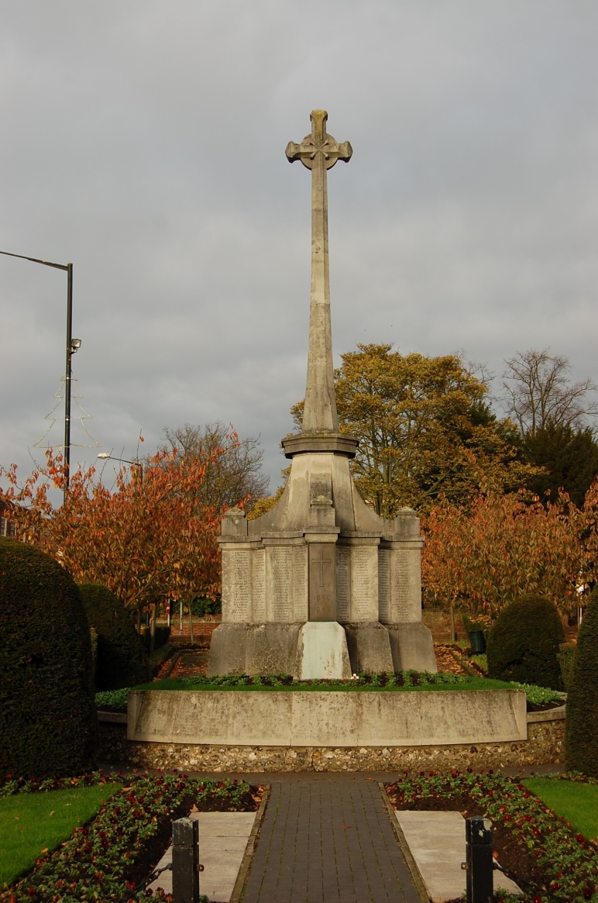
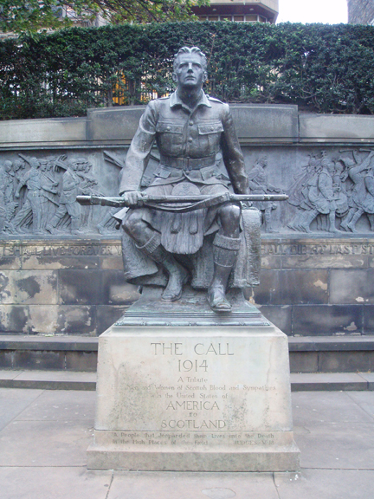
War memorials
Scottish American war memorial, Edinburgh (WM646) © War Memorials Trust, 2009
St Albans City war memorial, Hertfordshire (WM164) © St Albans City and District Council, 2011

Slide 5
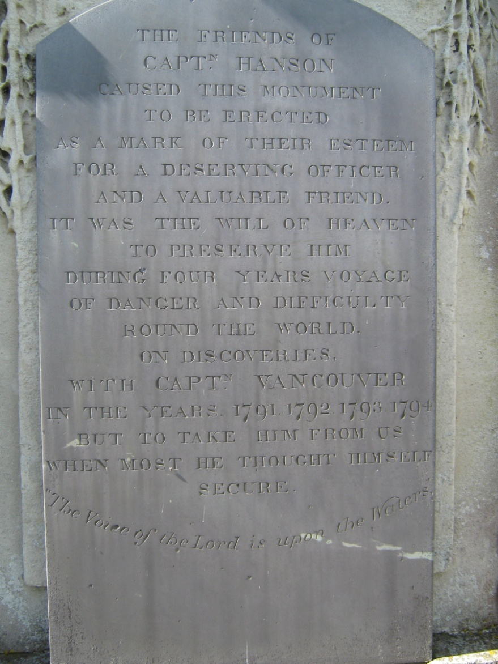
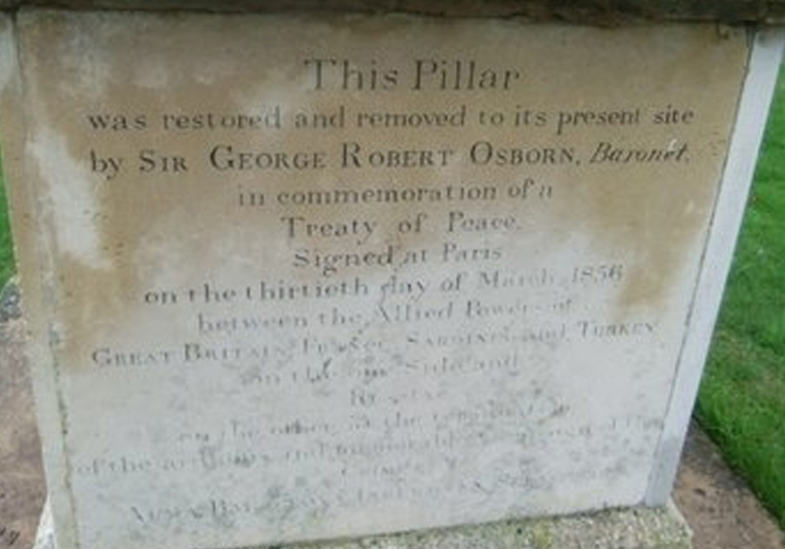
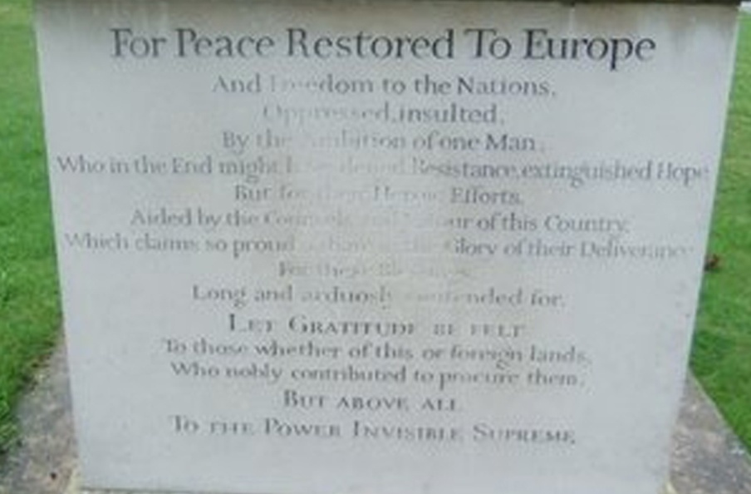
War memorials
Chicksands Napoleonic war memorial, Bedfordshire (WM916) ©Charly Fitzpatrick, 2010
Newhaven HMS Brazen memorial, East Sussex (WM4881) © Bill Highway, 2011

Slide 6
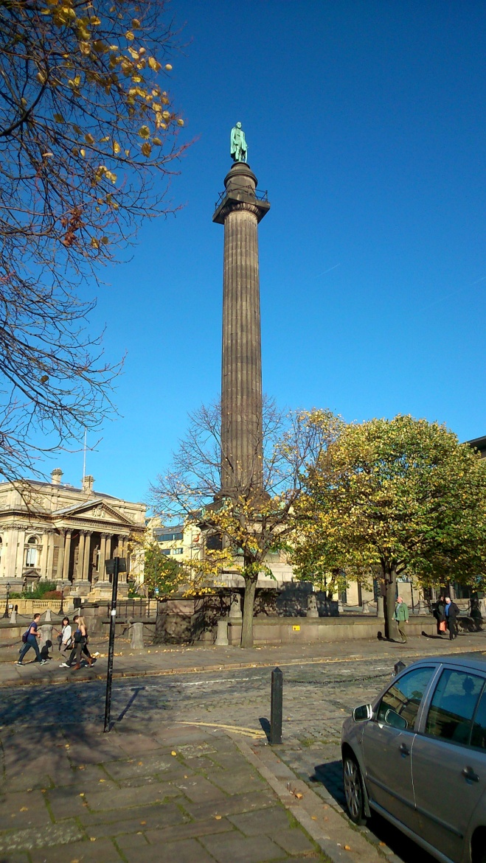
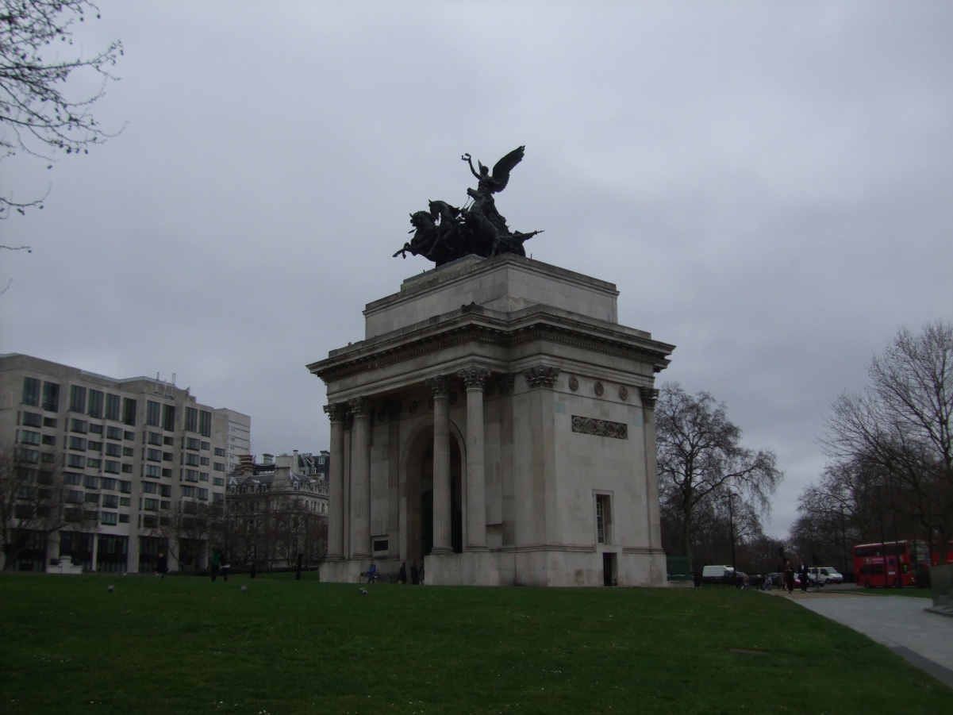
War memorials
Wellington Arch, London (WM6831) © War Memorials Trust, 2013
Duke of Wellington memorial, Liverpool (WM4795) © War Memorials Trust, 2013

Slide 7
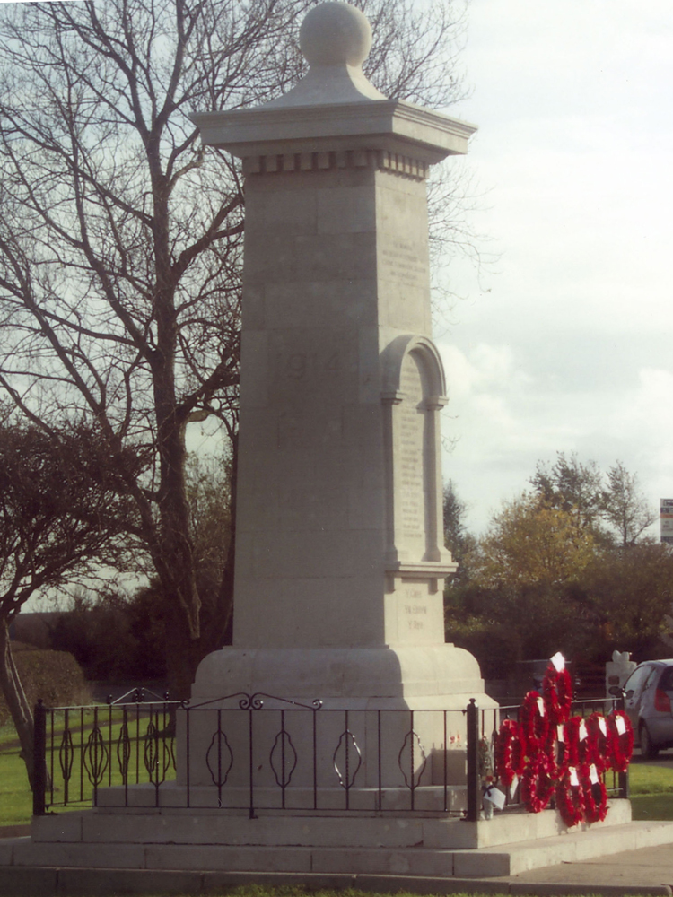
War memorials
100,000 in UK
Two thirds from First World War
Created by local communities – no rules on design and appearance
Focal point for remembering the fallen
St Athan, South Glamorgan (WM1910) © St Athan Community Council, 2006

Slide 8
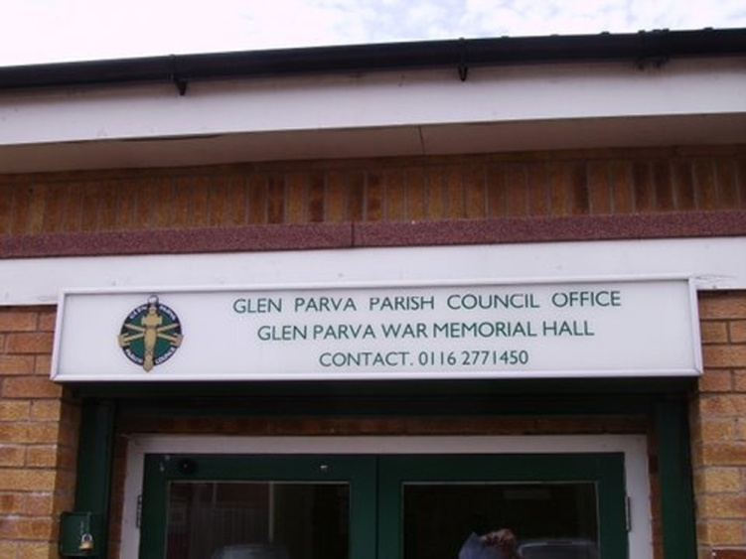
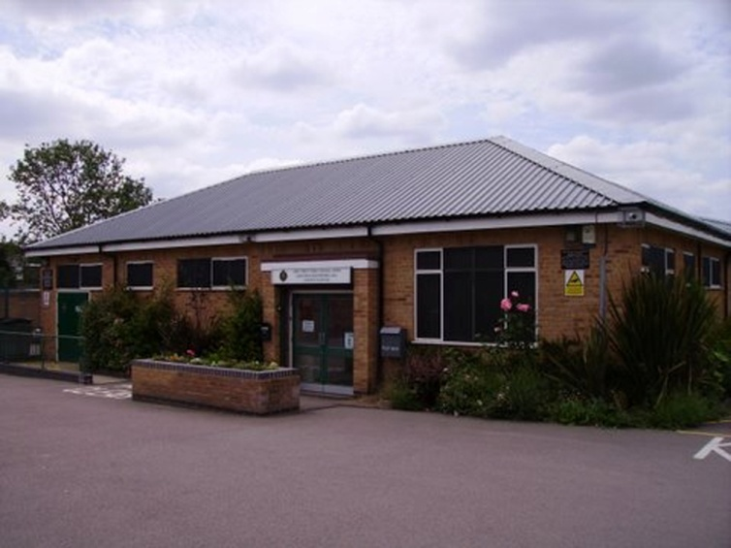
War memorials
Glen Parva memorial hall, Leicestershire (WM490) © D S Kenyon, 2010

Slide 9
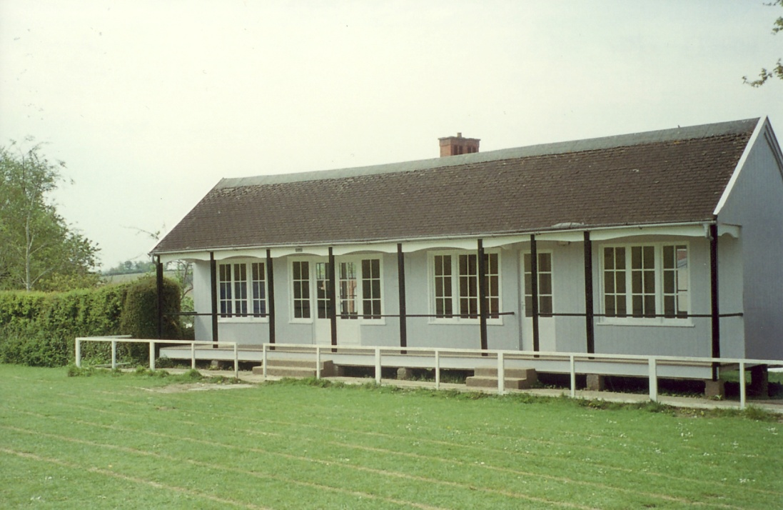
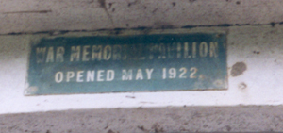
War memorials
Barnstaple Park Community School pavilion, Devon (WM933) © Park Community School, 2007

