Slide 1
War Memorials Trust
Assembly
Centenary of the Armistice

Slide 2
What do you know about this date?
11th November 1918

Slide 3
What led to the end of World War I?
1918
3rd March: Treaty of Brest-Litovsk agreed between Russia and Germany
21st March: Ludendorff Offensive begins
18th July: Allies stop German advance
8th August: Hundred Days Offensive
30th September: peace agreement with Bulgaria comes into effect

Slide 4
What led to the end of World War I?
1918
5th October: Hindenburg Line broken through
30th October: Ottoman Empire agrees a ceasefire
4th November: Austria-Hungary agrees a ceasefire
8th November: Germans and Allies meet to discuss peace
9th November: German Kaiser abdicates

Slide 5
What took place on 11th November?
1918
11th November
Armistice signed at 5.10am
Fighting ends at 11.00am

Slide 6
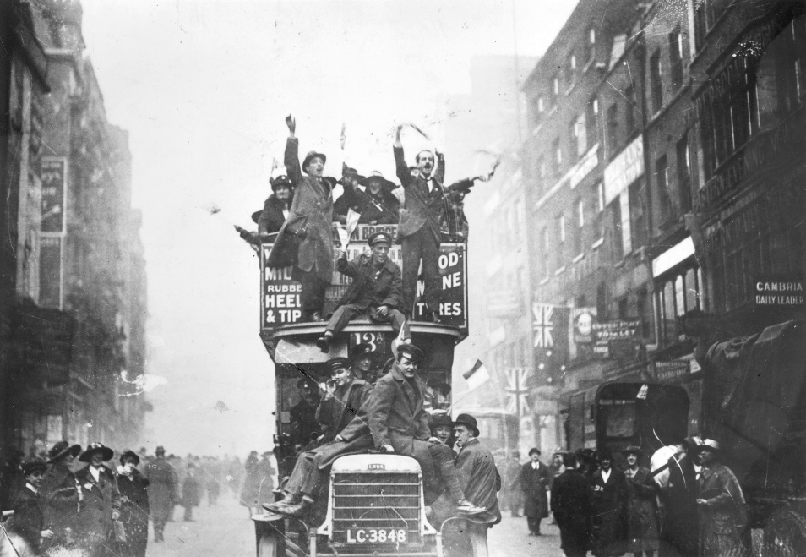
What took place on 11th November?
News of the Armistice spread quickly
Celebrations took place throughout Britain, France and the other Allied countries
Joyous mood tinged with sadness for those who lost their lives

Slide 7
What happened after the Armistice was signed?
1919
January: Paris Peace Conference attended by delegates from 32 countries
28th June: Treaty of Versailles signed at the Hall of Mirrors in the Palace of Versailles

Slide 8
Ode of Remembrance
They shall grow not old, as we that are left grow old,
Age shall not weary them nor the years condemn.
At the going down of the sun, and in the morning
We will remember them.

