Slide 1

War Memorials Trust
Assembly: Remembrance Day

Slide 2

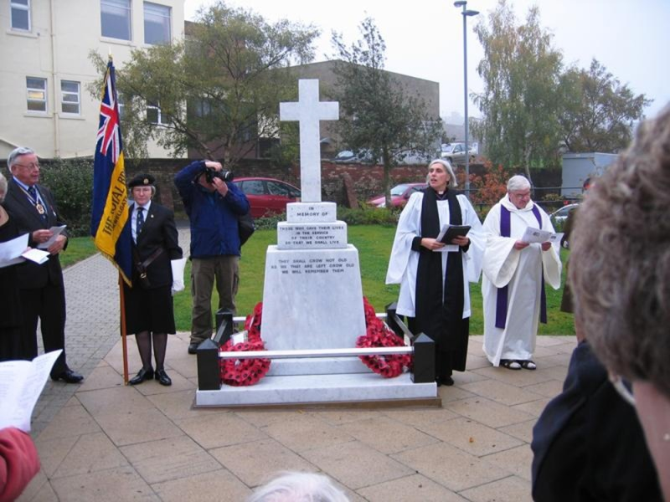
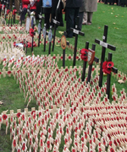
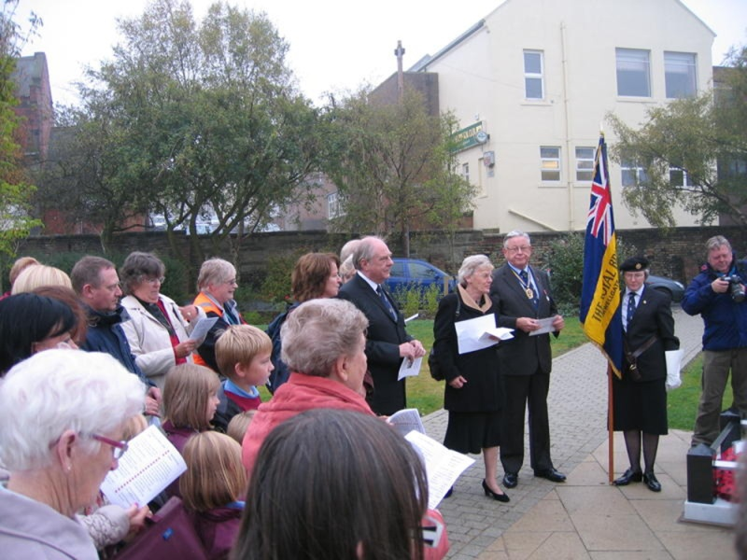
What happens on 11th November?
Field of Remembrance, London © WMT, 2012
Sacriston, County Durham © NEWMP, 2010

Slide 3
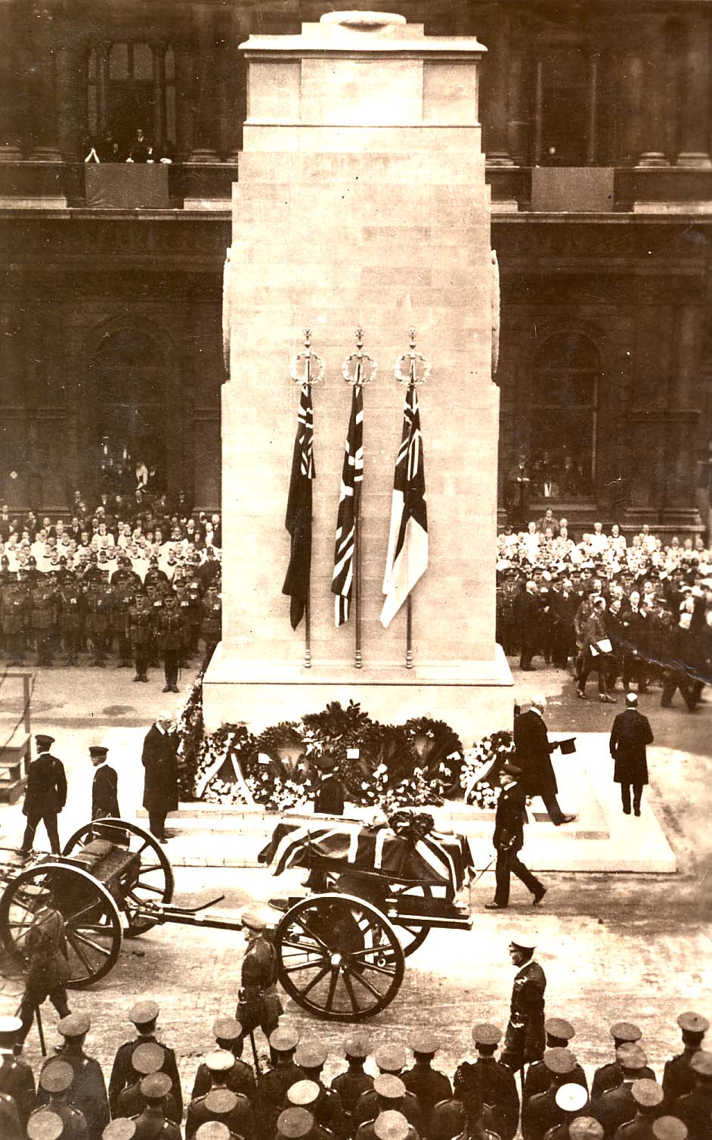
The First World War
Started on 4th August 1914
Ended on 11th November 1918 at 11am
Over 900,000 serving in the British Army died
Armistice Day now known as Remembrance Day
The unveiling of the Cenotaph, London 11th November 1920

Slide 4
In Flanders fields
In Flanders fields the poppies blow
Between the crosses, row on row,
That mark our place; and in the sky
The larks, still bravely singing, fly
Scarce heard amid the guns below.
We are the Dead. Short days ago
We lived, felt dawn, saw sunset glow,
Loved and were loved, and now we lie,
In Flanders fields.
Take up our quarrel with the foe:
To you from failing hands we throw
The torch; be yours to hold it high.
If ye break faith with us who die
We shall not sleep, though poppies grow
In Flanders fields.

