Slide 1

War Memorials Trust
UK memorials to Dunkirk

Slide 2

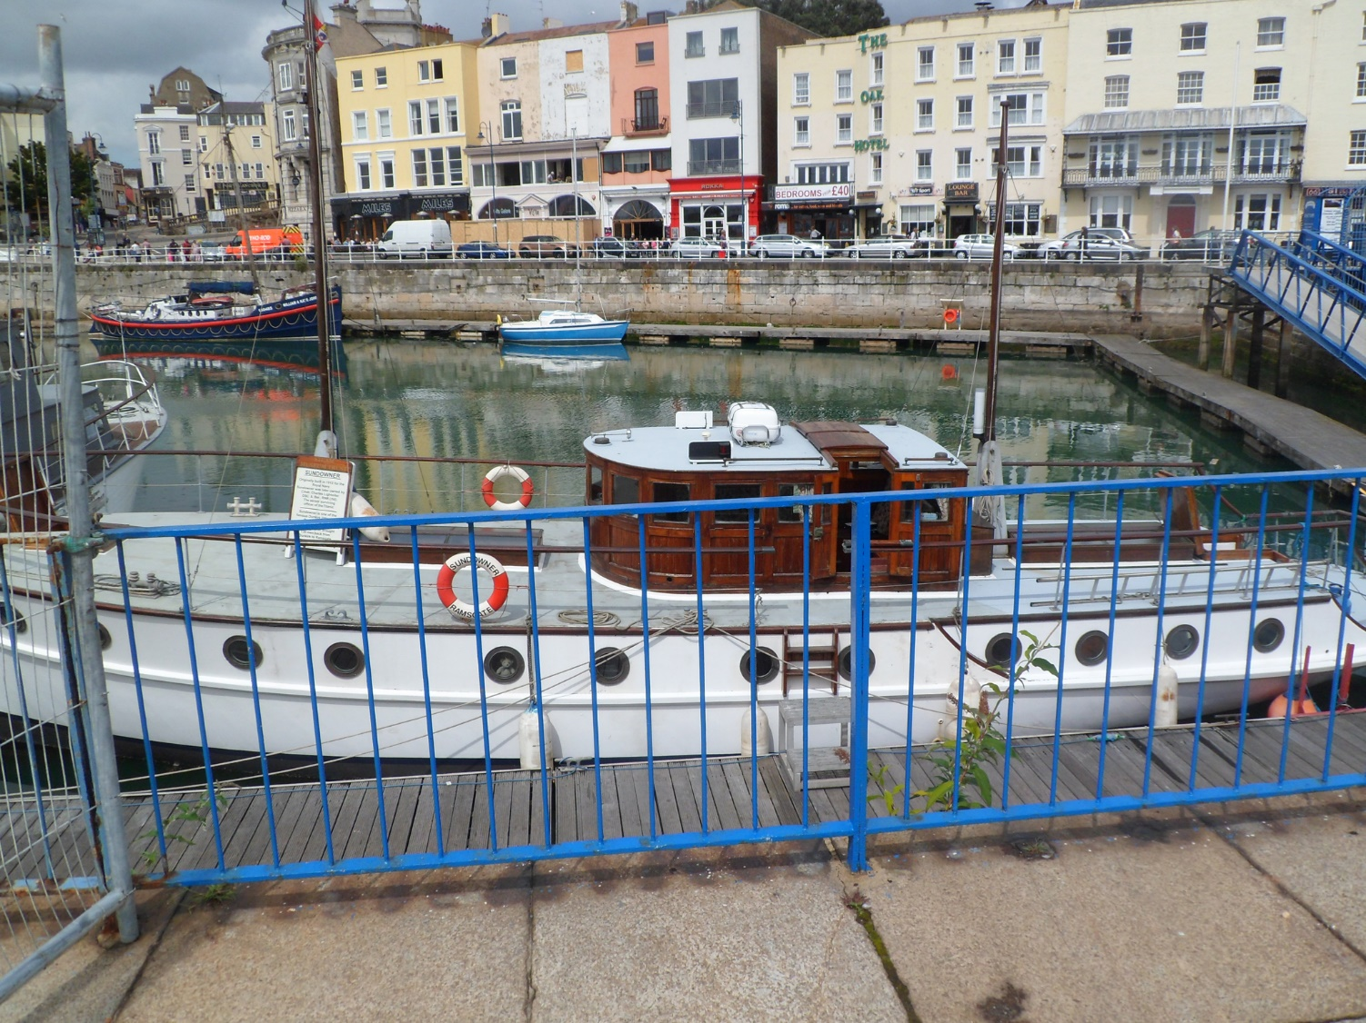
Dunkirk memorials
Sundowner, Ramsgate, Kent. One of the ‘Little Ships’ that helped evacuate men from Dunkirk. © War Memorials Trust, 2014.

Slide 3
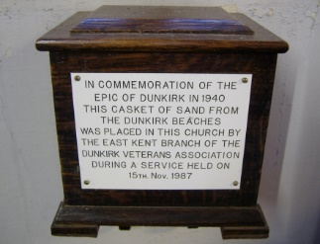
Dunkirk memorials
Dunkirk casket containing sand from the beaches. St George the Martyr Church, Ramsgate, Kent. © James Brazier, 2008.

Slide 4
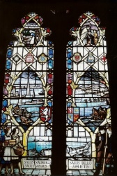
Dunkirk memorials
Dunkirk stained glass window depicting the evacuation. St George the Martyr Church, Ramsgate, Kent. © James Brazier, 2008.
What else can be seen in the images in the window?

Slide 5
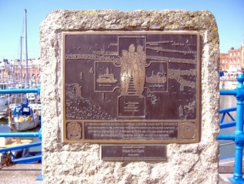
Dunkirk memorials
Memorial stone in Ramsgate Harbour, Kent © James Brazier, 2007
The stone shows scenes from the evacuation.

Slide 6
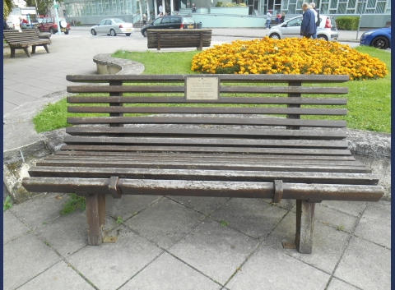
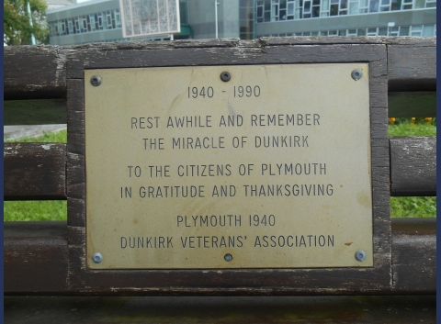
Dunkirk memorials
Memorial bench located in Plymouth giving thanks for the ‘Miracle of Dunkirk’ © Mr C E Moreton, 2013
What does the inscription suggest about views of Dunkirk when the memorial was created?

Slide 7
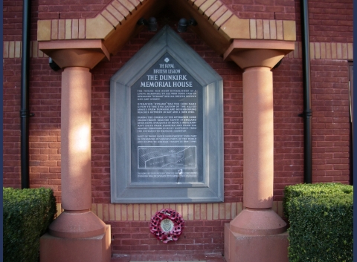
Dunkirk memorials
Plaque outside Dunkirk memorial house care home, Somerset © War Memorials Trust, 2015.

