Slide 1
War Memorials Trust
UK memorials to the Battle of Britain

Slide 2
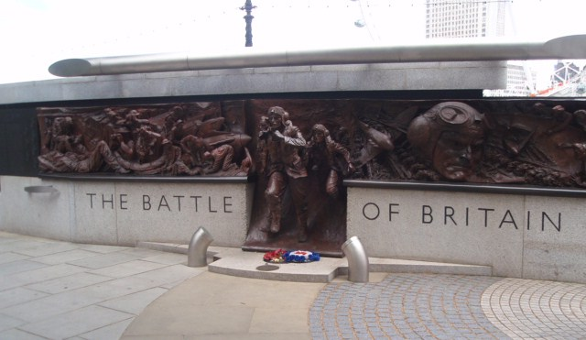
Battle of Britain memorials

Slide 3
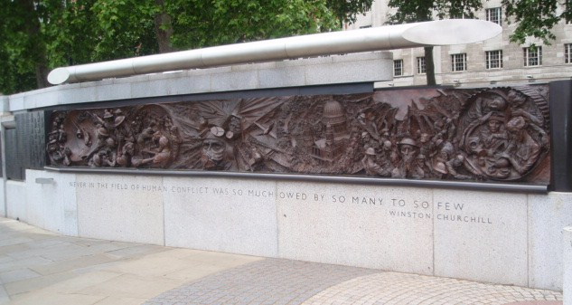
Battle of Britain memorials
Battle of Britain memorial, London. The sculptures depict aspects of life at the time of the battle, people involved and airmen who fought. It is a useful way of examining different aspects of the war.

Slide 4
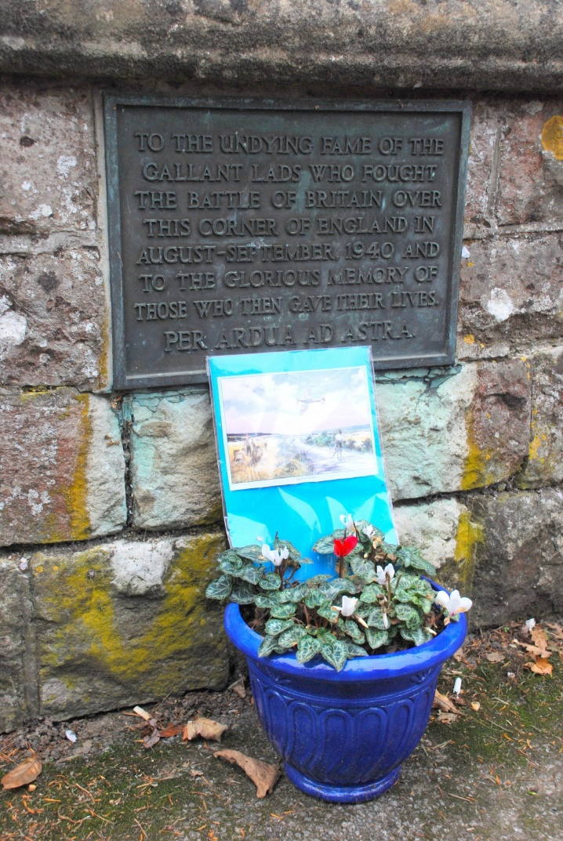
Battle of Britain memorials
This memorial is outside All Saints Church in Brenchley, Kent. It consists of a small plaque fixed to the wall near to the lychgate that leads into the churchyard. It is a simple memorial but pays tribute to the ‘lads’ who fought and given that the memorial is close to where some of the battle happened it is quite a personal memorial from a place directly affected by it.
© Les Featherstone, 2013.

Slide 5
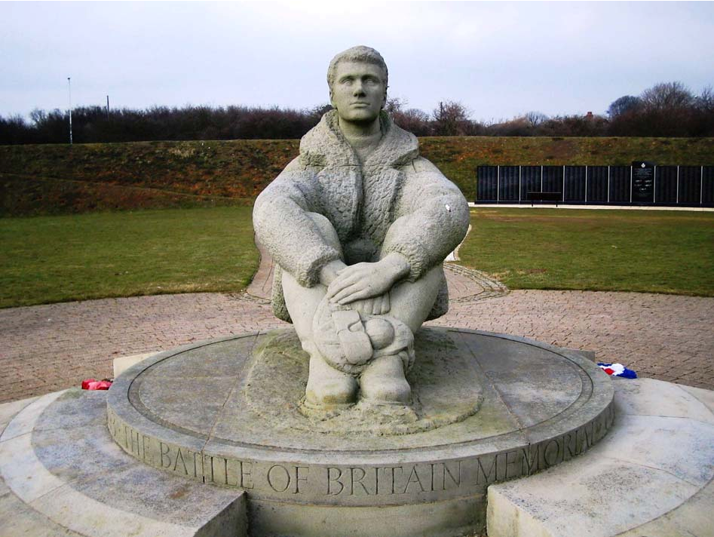
Battle of Britain memorials
This shows the airman statue at Capel le Ferne Battle of Britain memorial. He is situated so he looks out to the coast close to where significant air battles happened.
© Les Featherstone, 2013.

Slide 6
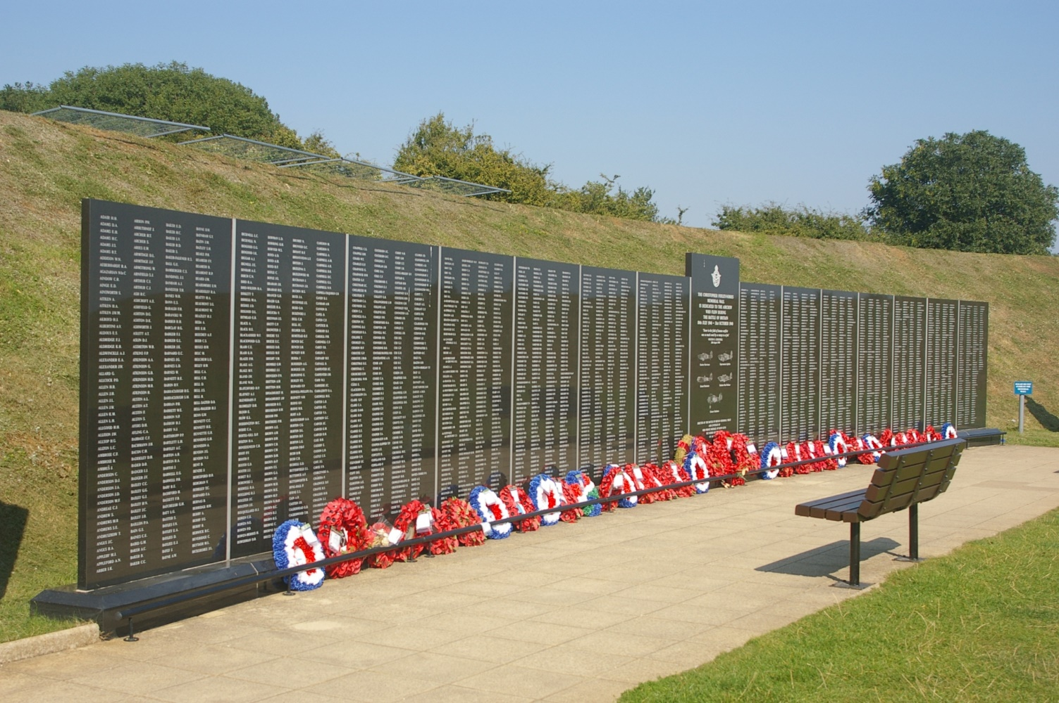
Battle of Britain memorials
The plaques situated near the airman statue at Capel le Ferne memorial. It lists those who flew in the Battle of Britain.
© RM Bigrigg, 2013.

Slide 7
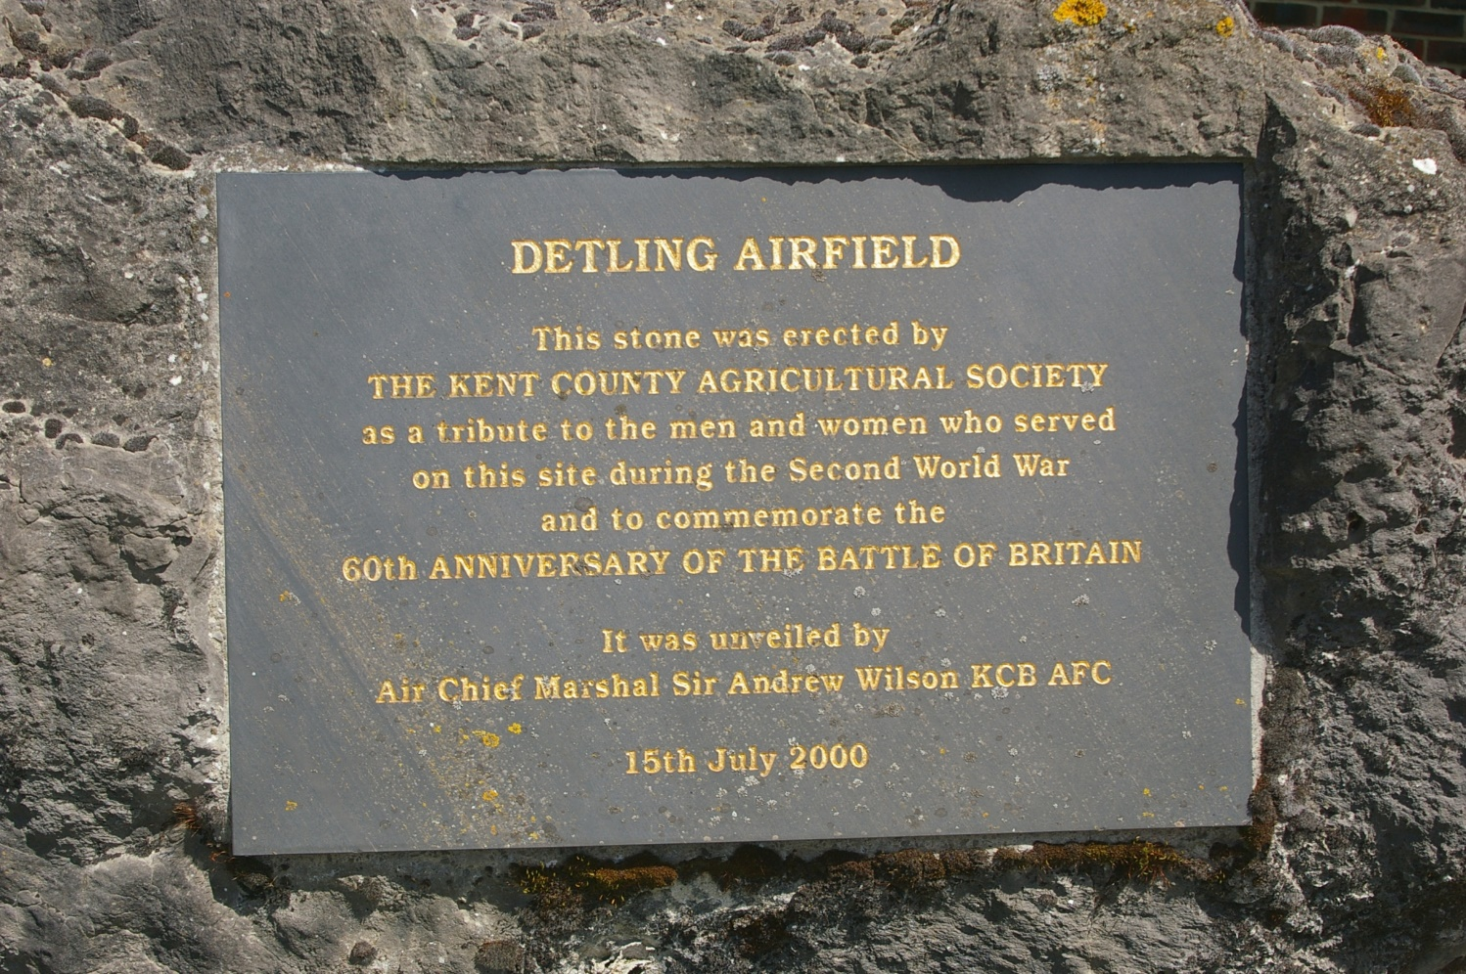
Battle of Britain memorials
Commemorative plaque at Detling airfield, Kent. It was unveiled in 2000 to mark the 60th anniversary of the Battle of Britain.
© RM Bigrigg, 2013.

Slide 8
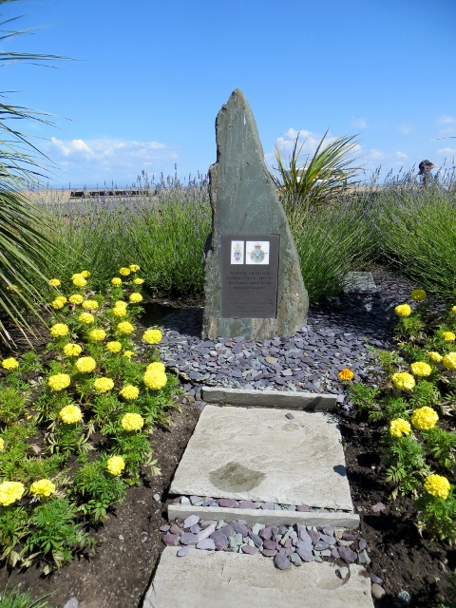
Battle of Britain memorials
This memorial is a stone monument set in a small garden area. The plaque on the front face bears the RAF crest, a local coat of arms and the words of Winston Churchill praising ‘The Few,’ the airmen who fought the Battle of Britain.
© Philip Platt, 2014

Slide 9
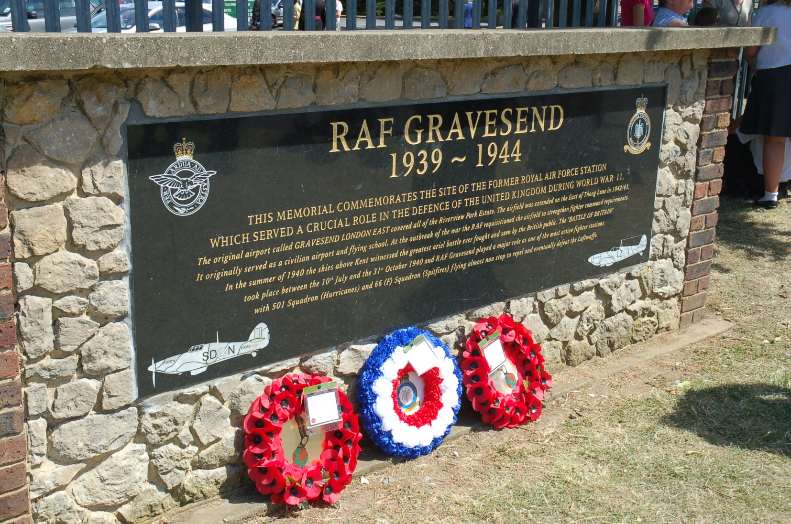
Battle of Britain memorials

Slide 10
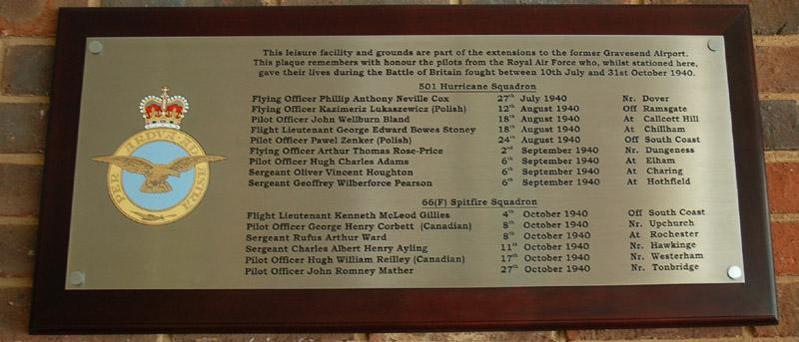
Battle of Britain memorials
The photos on this and the previous slide show the plaques situated on the site of RAF Gravesend, which is now a leisure centre. They show that, while the site’s use has changed, the battle is still a key part of local heritage. © Michael Mitchell, 2010.

Slide 11
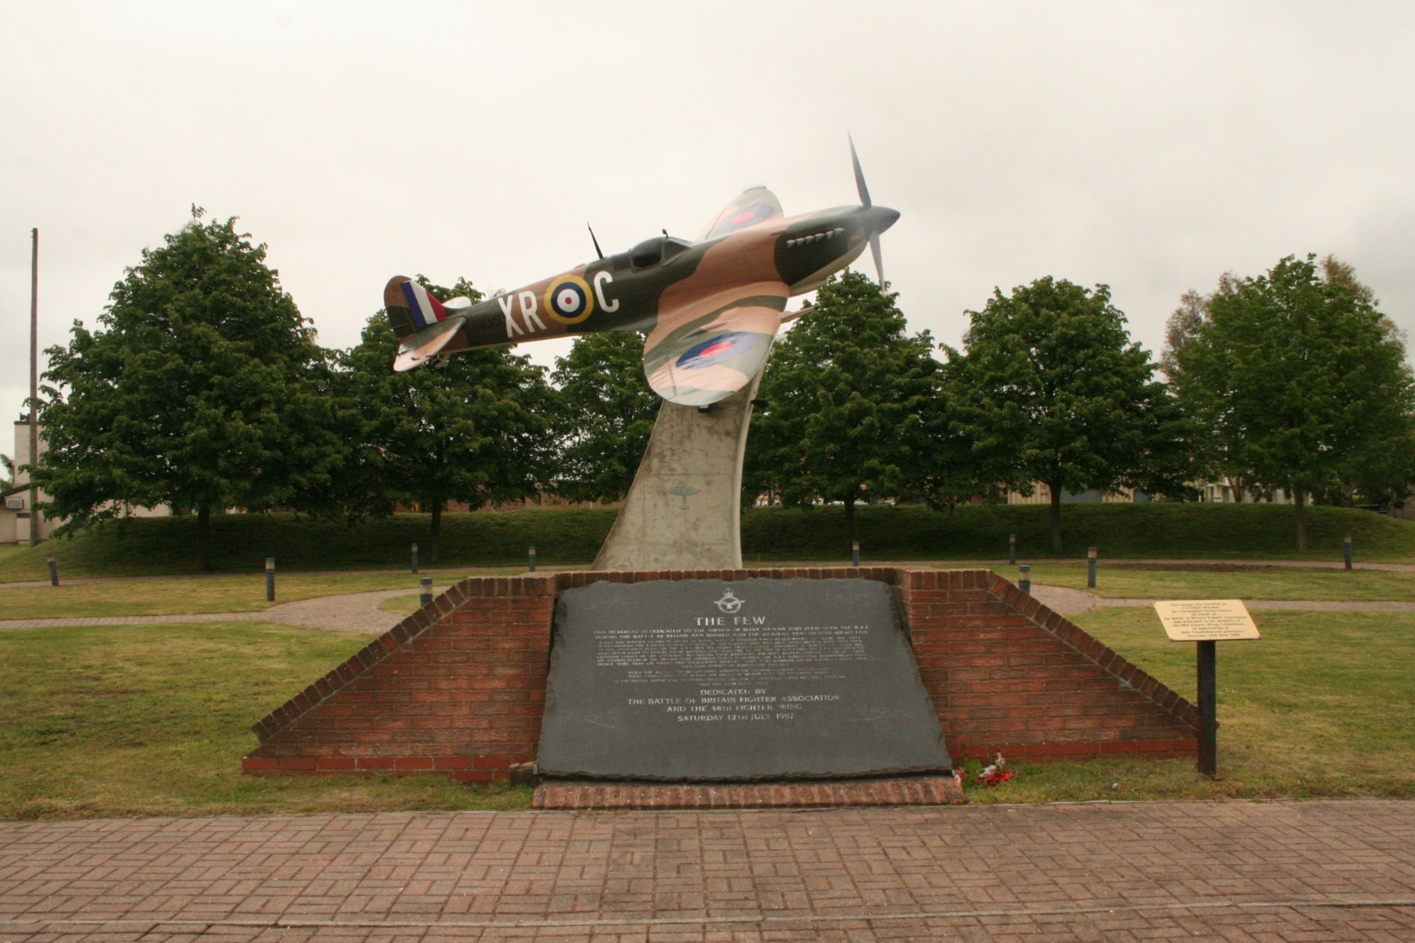
Battle of Britain memorials

Slide 12
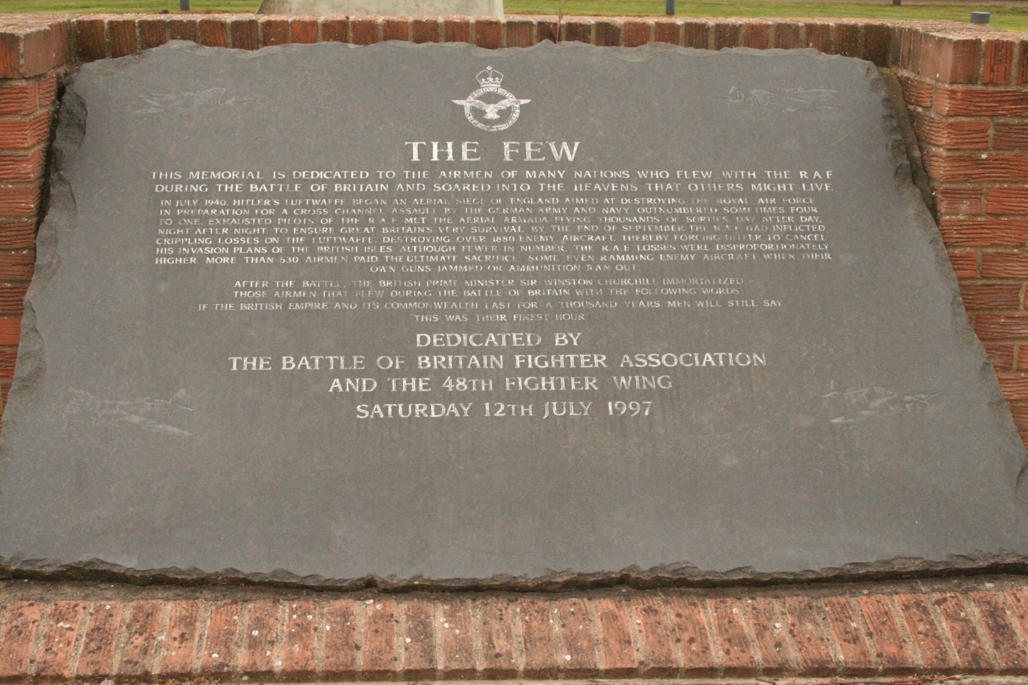
Battle of Britain memorials
This and the previous slide show the Battle of Britain memorial at RAF Lakenheath, Suffolk. This plaque mentions the men of many nations who flew with the RAF, and gives information about the battle.
© P Steele, 2016.

Slide 13
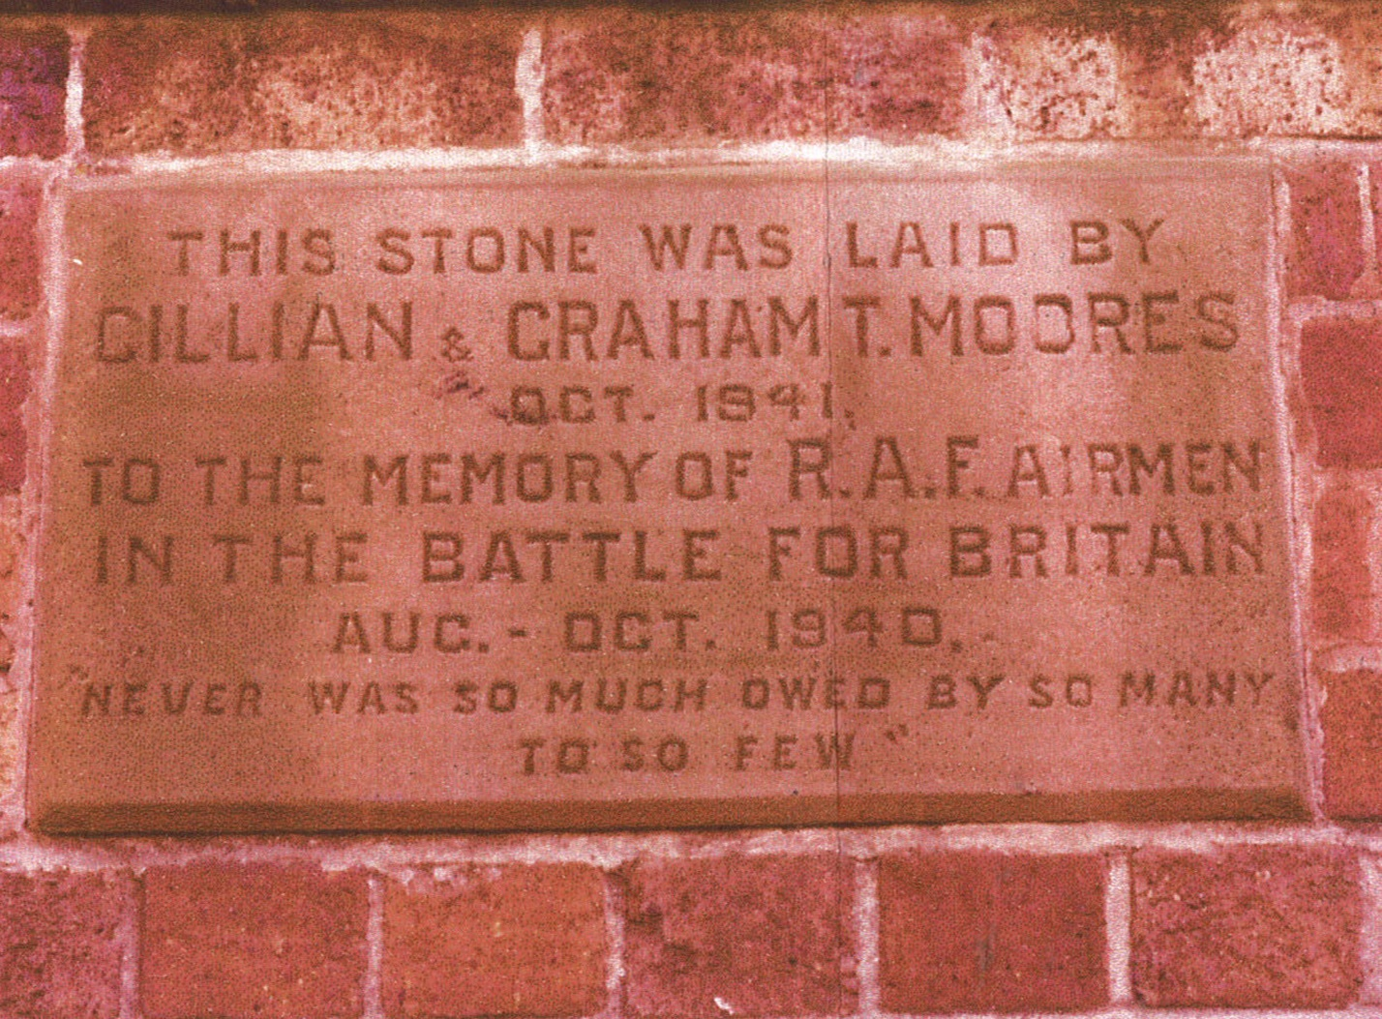
Battle of Britain memorials
This is the Battle of Britain memorial plaque at Sandbach, Cheshire. The plaque is on the side of a house and was laid just a year after the battle.
© G Moores, 1978.

