Slide 1

War Memorials Trust
UK memorials to the Blitz

Slide 2

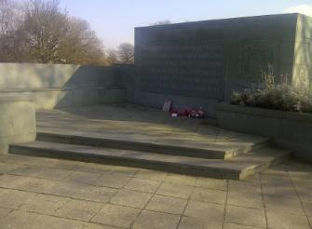
Blitz memorials
Anfield Cemetery civilian memorial, Liverpool © David Hearn, 2016.
The plaque on the stone wall explains that all victims of the Blitz are remembered, many of whom are buried in the cemetery.

Slide 3
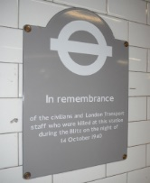
Blitz memorials
Memorial plaque at Balham Underground station © Wandsworth Borough Council, 2015.
The plaque remembers the people who died when an air raid caused damage to the station where people were sheltering on 14th June 1940.
Why were underground stations used as shelters? Which others were used?

Slide 4
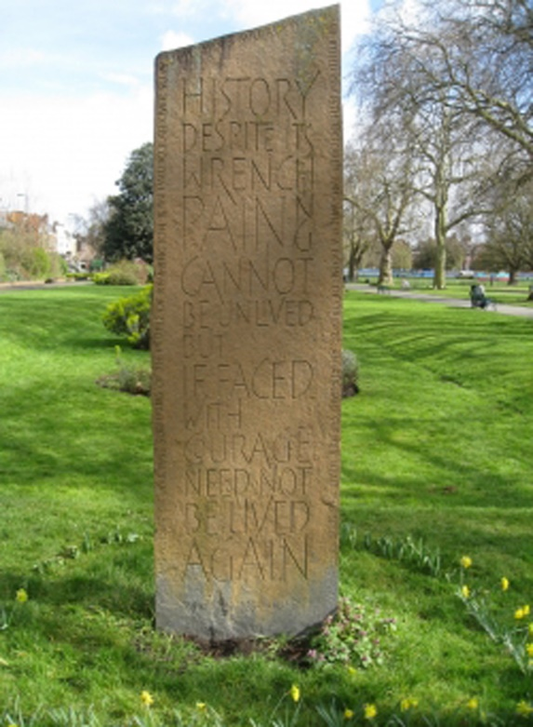
Blitz memorials
Another memorial to civilians who died during a disaster affecting air raid shelters. This memorial is on the site on a collapsed shelter in Kennington Park, London, where 104 people died after a bomb fell on it in 1940.
© Martin Shorthouse, 2015

Slide 5
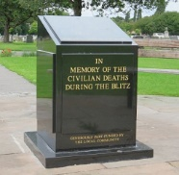
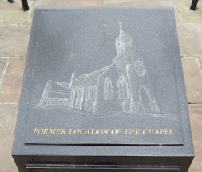
Blitz memorials
Civilian memorial in Bootle Cemetery. The top depicts the chapel which used to be where the memorial now is © Paul Charlesworth, 2014

Slide 6
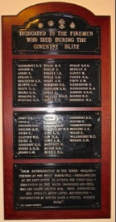
Blitz memorials
Memorial plaque to Coventry’s firemen who died during the Blitz on the city. 56 names are listed along with one ‘unidentified’ entry. © Terry Reeves, 2015.
This memorial could be used as a starting point for finding out what other jobs civilians had to do during the Blitz and the rest of the war.

Slide 7
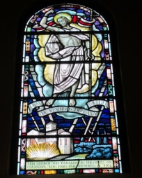
Blitz memorials
Stained glass memorial window in Coventry’s Catholic Church of the Precious Blood and All Souls.
It shows scenes of bomb damage and searchlights in the sky. The inscription running along the bottom of the window under this scene reads ‘This church was damaged in the blitz on Coventry, Nov. 1940, and restored in 1962.‘ © Sarah James, 2015.

Slide 8
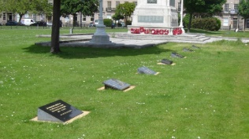
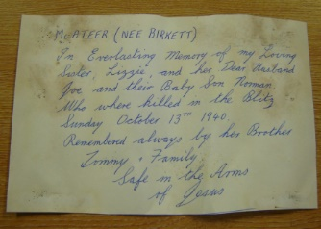
Blitz memorials
The top photo shows the main war memorial monument in Hamilton Square, Liverpool. Smaller plaques, one of which commemorates the Blitz, can be seen surrounding it. The letter was placed in a time capsule nearby and is an example of a very personal memorial to individual members of someone’s family.
© Peter Jackson-Lee, 2009.

Slide 9
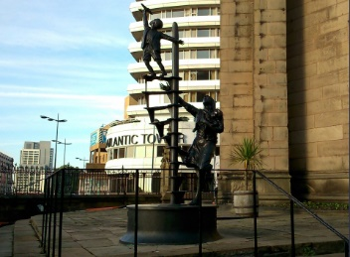
Blitz memorials
Memorial sculpture commemorating the Blitz in Liverpool and Bootle between 1940 and 1942. This is an interesting example of a more modern memorial design.
© War Memorials Trust, 2013.

Slide 10
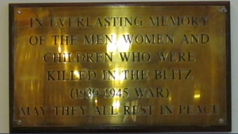
Blitz memorials
Memorial plaque in Wallasey Town Hall, Liverpool © John Robinson, 2012. This simple memorial commemorates all civilians killed in World War II.

Slide 11
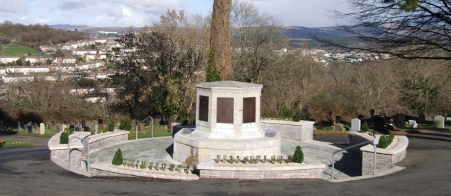
Blitz memorials
Civilian memorial in Efford Cemetery, Plymouth. Names of those commemorated are listed on six plaques on the top part of the monument. © Plymouth City Council, 2011.

