Slide 1

War Memorials Trust
UK memorials to the Holocaust

Slide 2

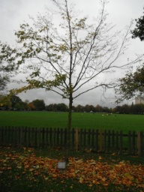
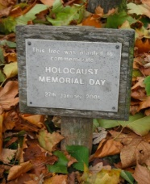
Holocaust memorials
Holocaust memorial tree on Wandsworth Common, London. The tree was planted to commemorate Holocaust Memorial Day
© Wandsworth Borough Council, 2013

Slide 3
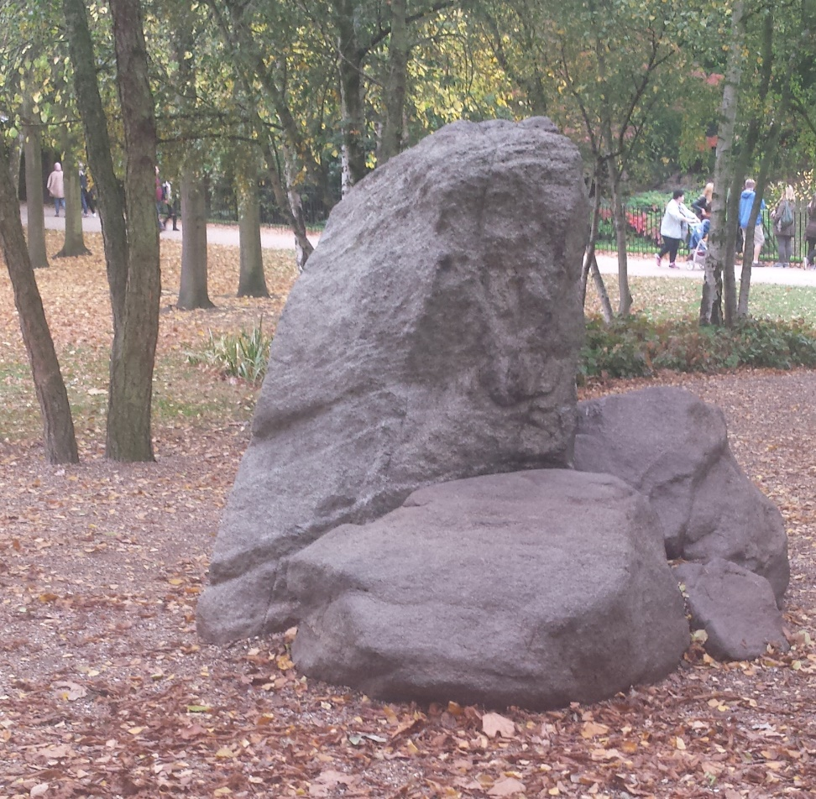
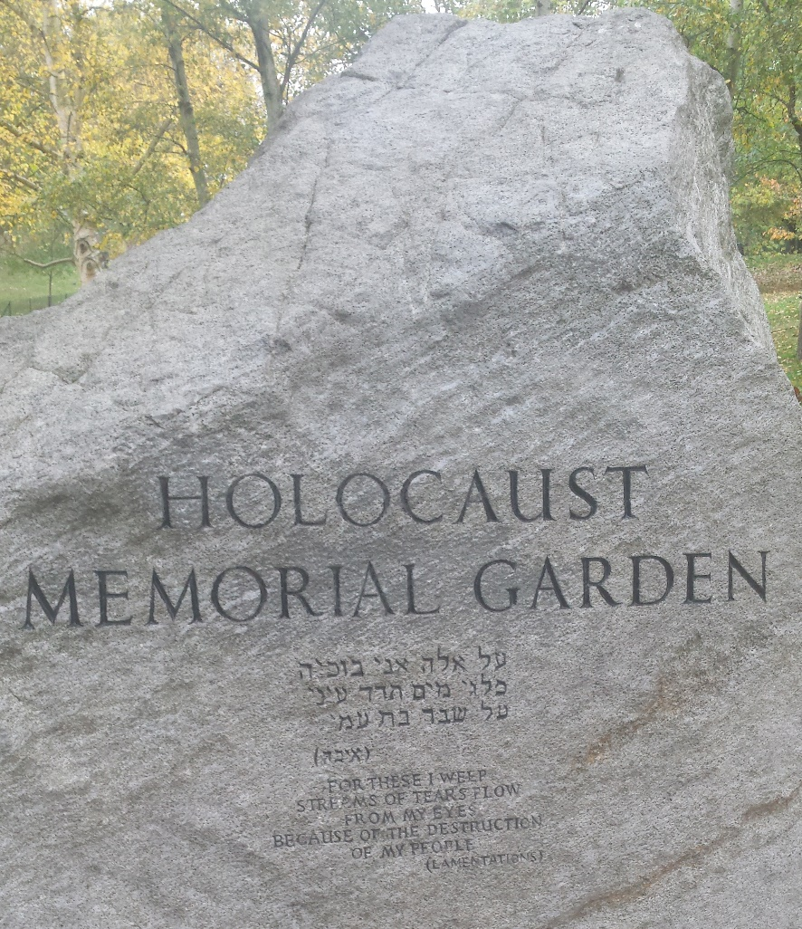
Holocaust memorials

Slide 4
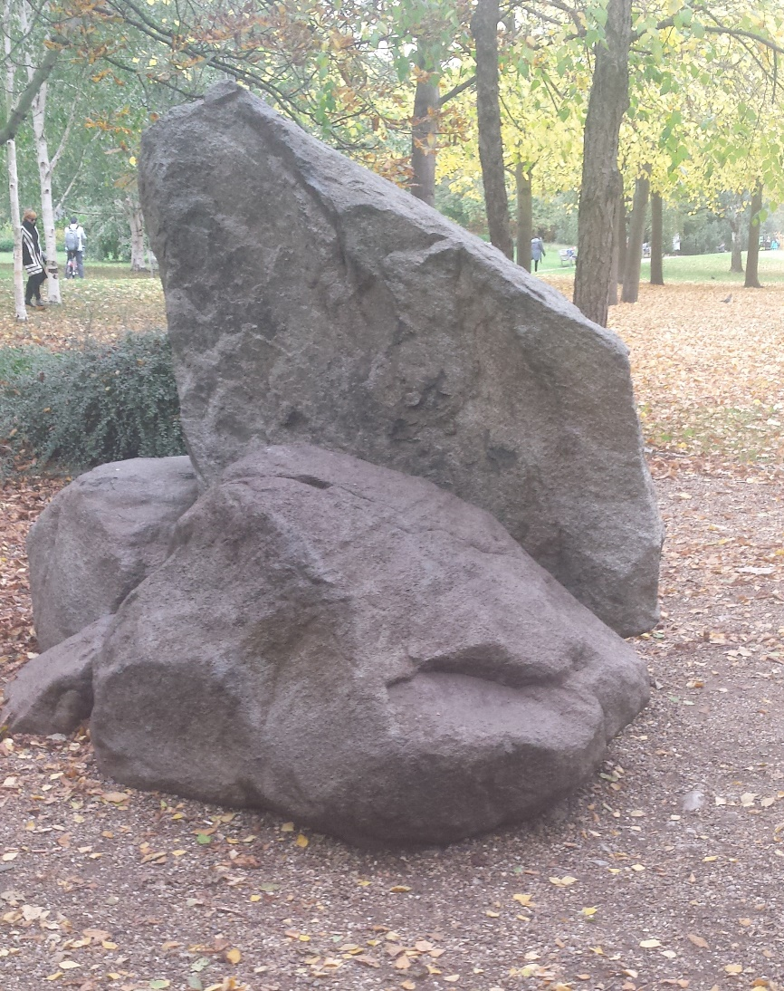
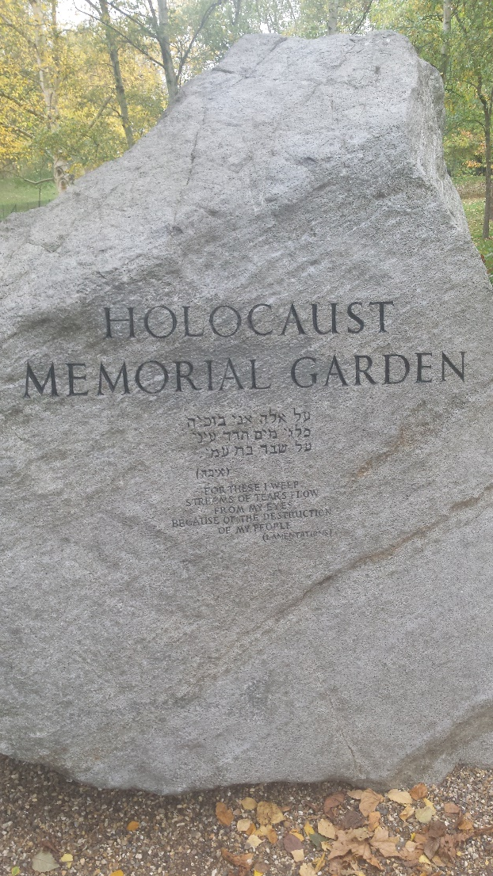
Holocaust memorials
Holocaust memorial garden in Hyde Park, London. A remembrance service is held here every year.
© War Memorials Trust, 2016

Slide 5
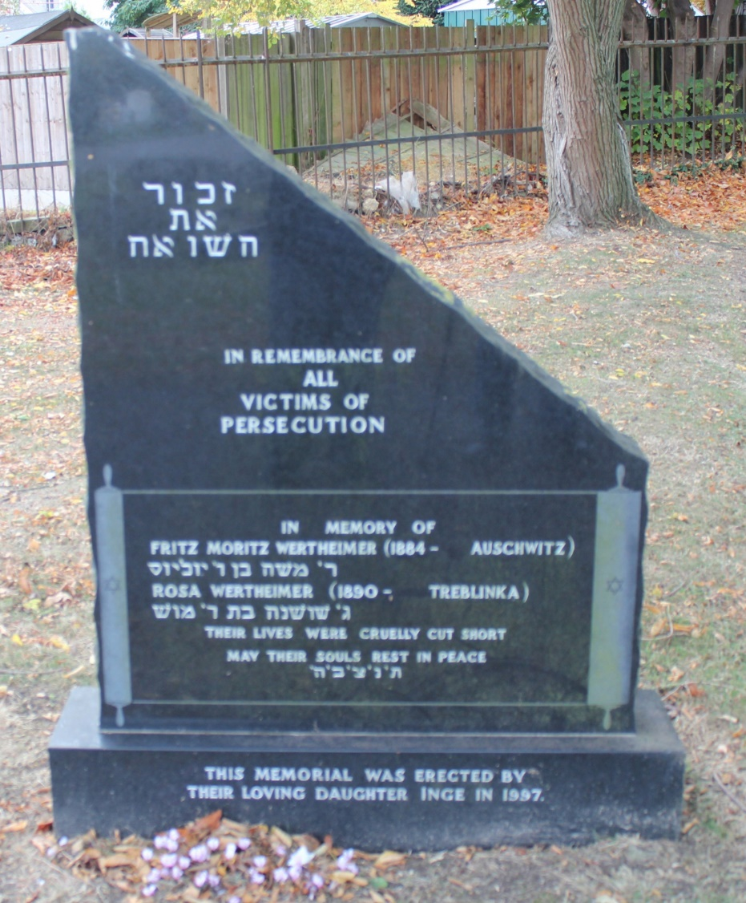
Holocaust memorials
Holocaust memorial in Chatham Cemetery, Kent. It is dedicated to two specific victims of the Holocaust and was created by their daughter.
It is located in the Jewish section of the cemetery.

Slide 6
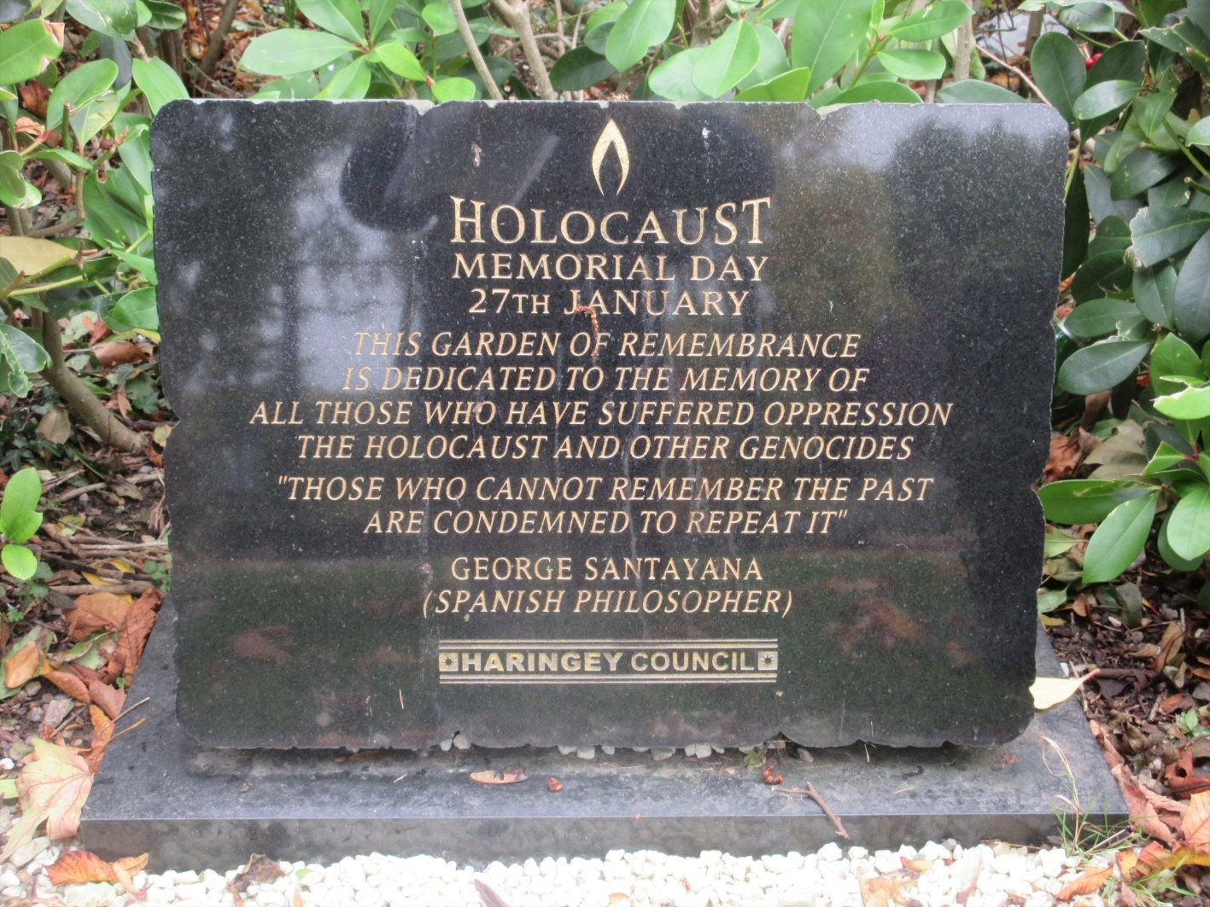
Holocaust memorials

Slide 7
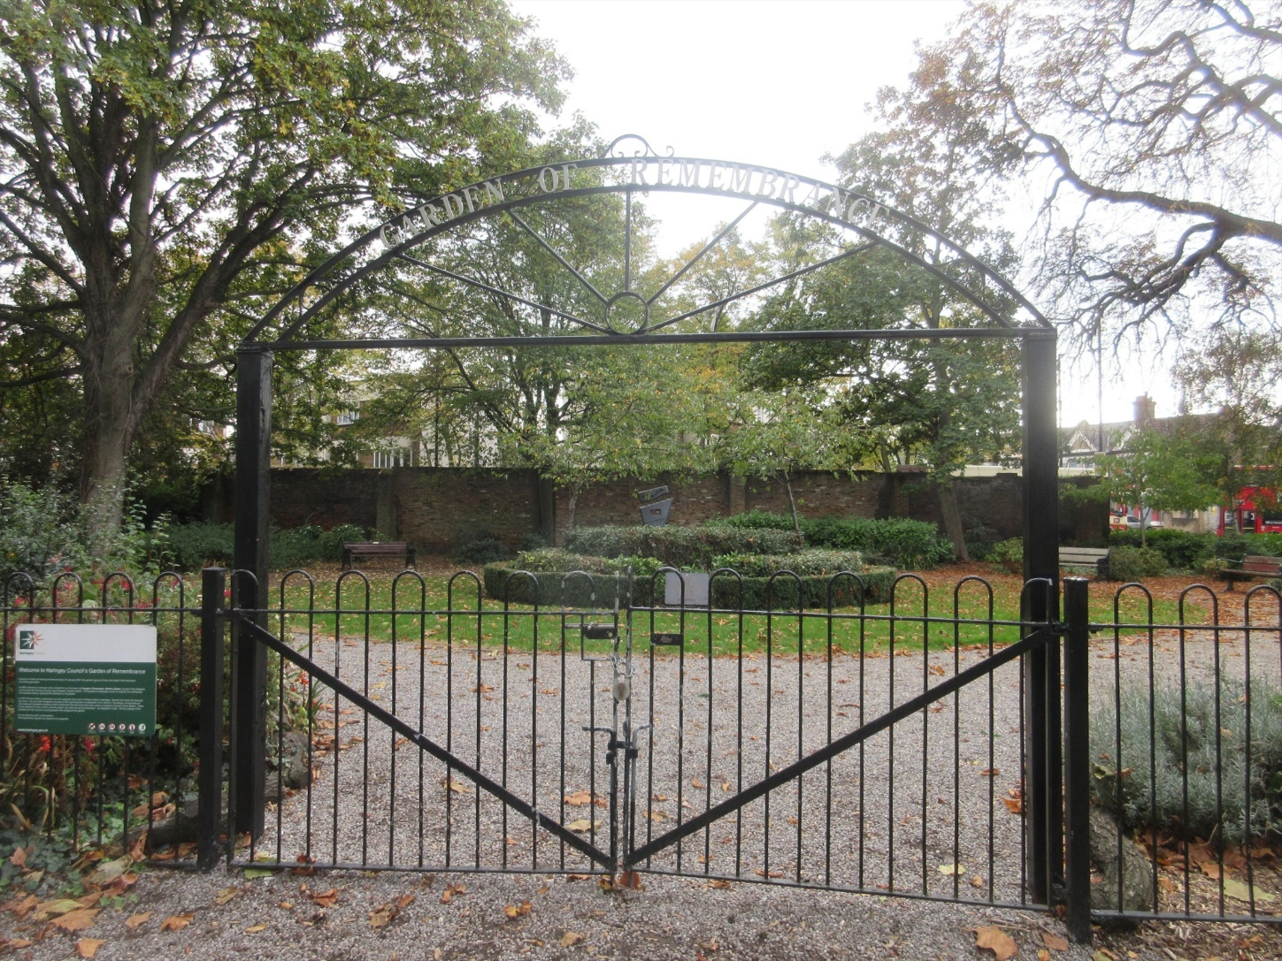
Holocaust memorials

Slide 8
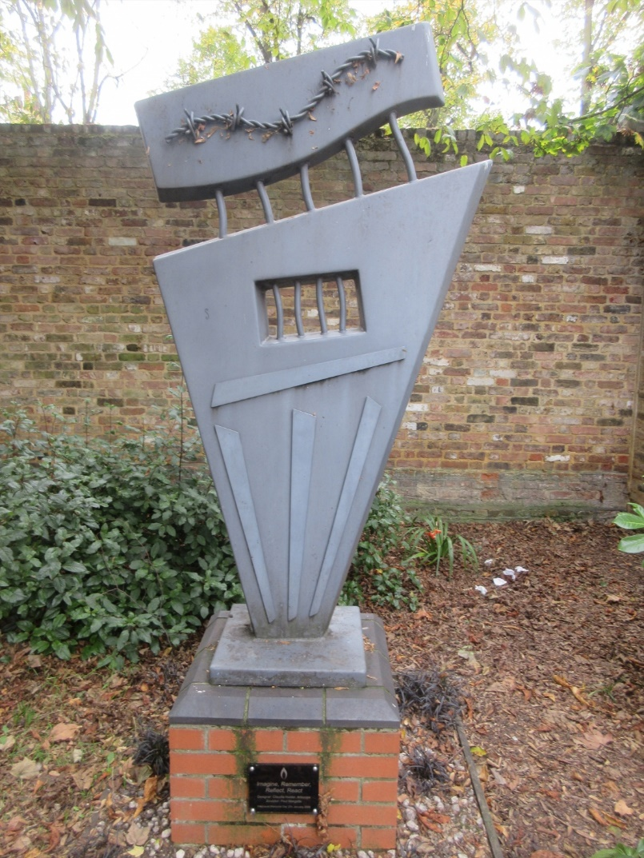
Holocaust memorials
The photos on this and the previous two slides show a memorial to the Holocaust in Tottenham, London. It consists of a garden with seating and planted areas, and this unusual sculpture with barbed wire shown.
Like the Hyde Park memorial it uses more abstract imagery to portray the subject commemorated, and can be compared to more traditional memorials
© Martin Shorthouse, 2016

Slide 9
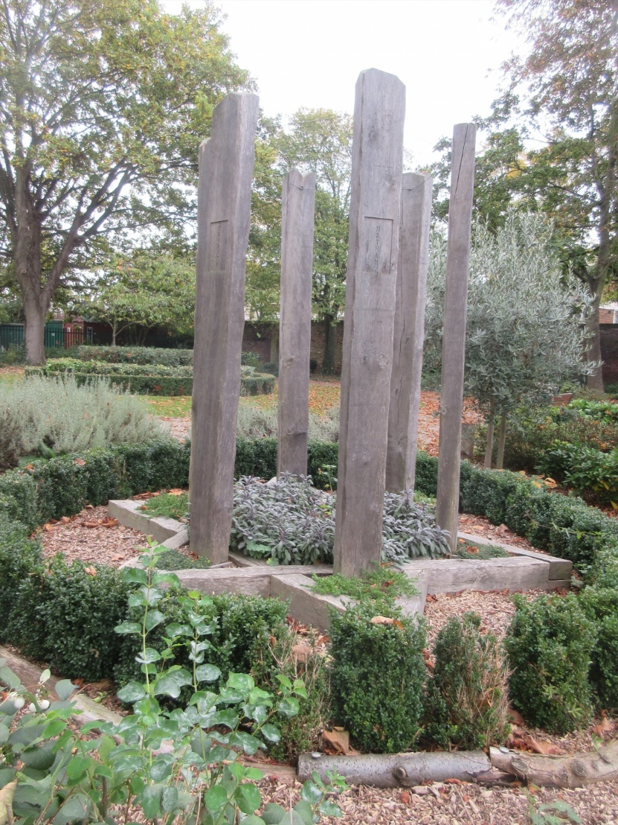
Holocaust memorials
This is another unusual memorial sculpture commemorating the Holocaust, also in Tottenham, London.
Each of the six pillars represents one million victims, and these are arranged in a Star of David shape.
This is a good example of how symbolism can be used in war memorials.
© Martin Shorthouse, 2016

Slide 10
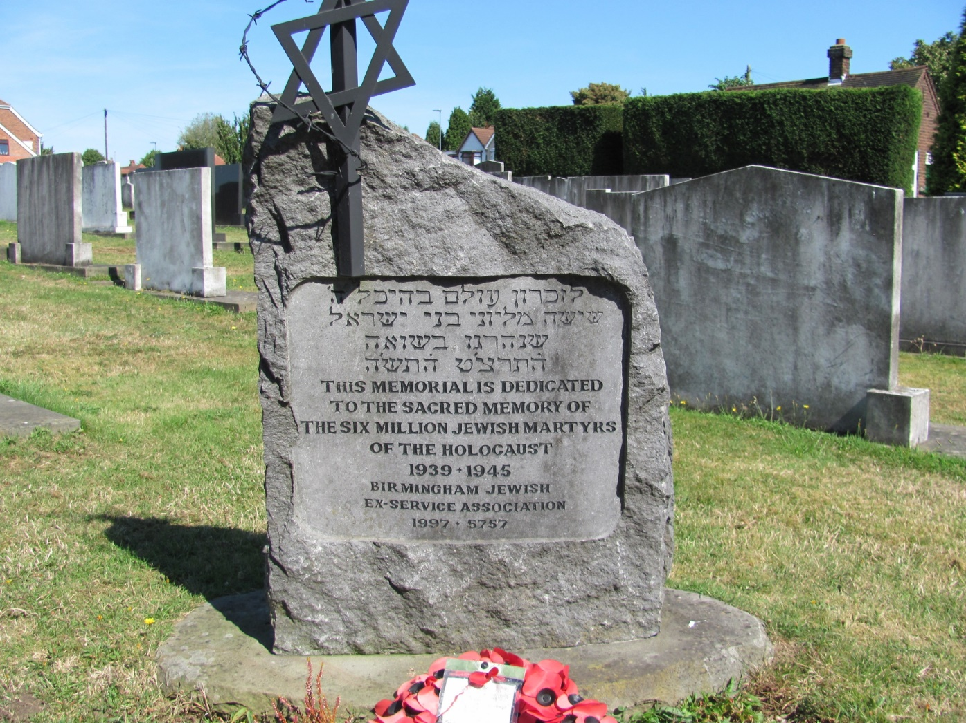
Holocaust memorials
Holocaust memorial in Witton Jewish Cemetery, Birmingham.
© Tony Woolley 2016

