Slide 1

War Memorials Trust
What is Remembrance?

Slide 2

Remembrance

Slide 3
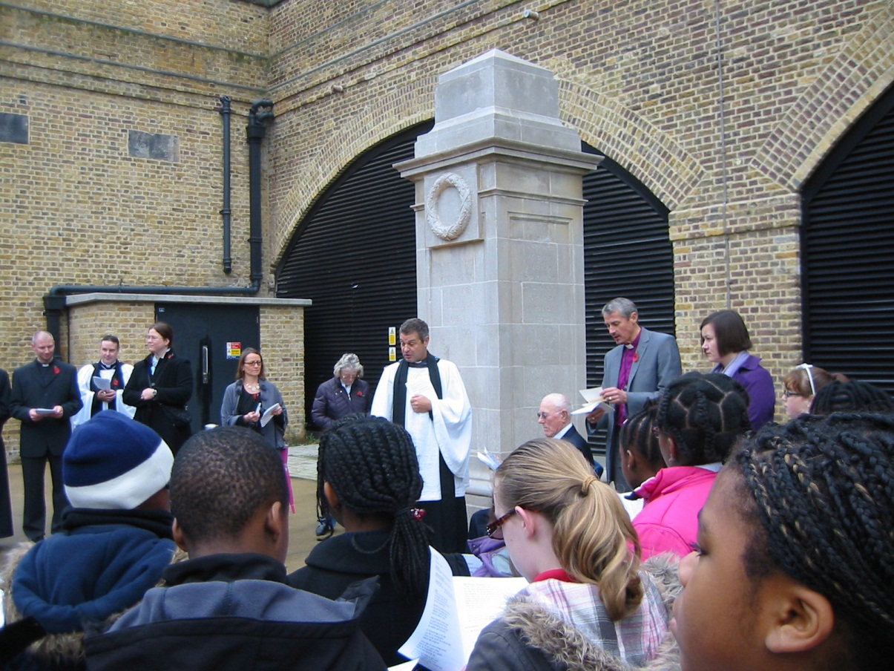
What are they remembering?
What are they doing?
Who are they thinking about?
How do you know?
Hoxton, London (WM5096) © War Memorials Trust, 2011

Slide 4
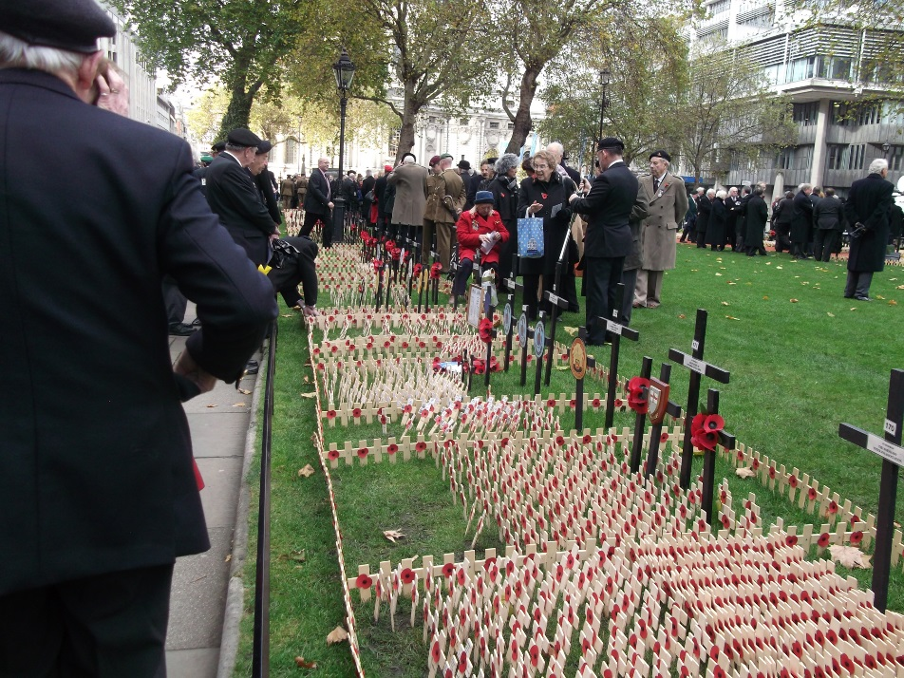
Learning Objectives:
Know when the First and Second World Wars happened
Know why November 11th is known as Remembrance Day
Know how Remembrance Day is marked
Field of Remembrance © War Memorials Trust, 2012

Slide 5
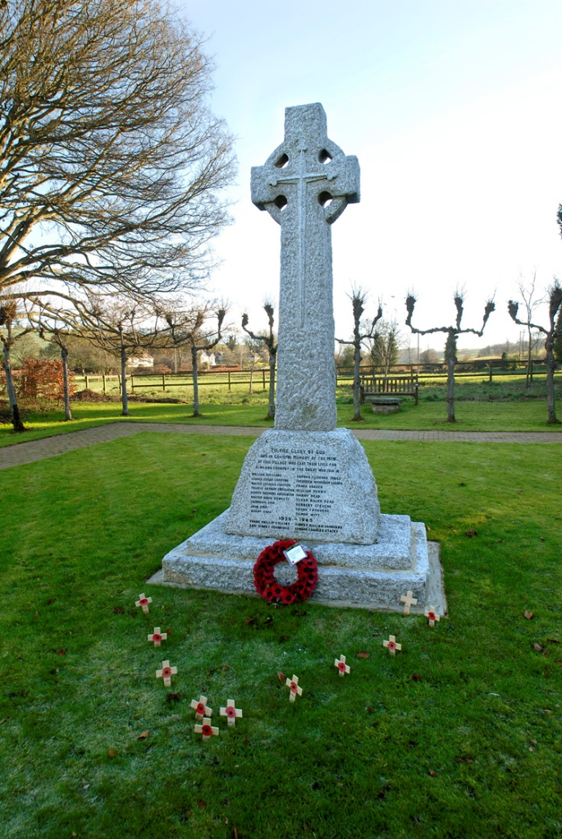
Learning Outcomes:
Explain when the events that are remembered took place
Describe what usually happens on Remembrance Day and why it is around 11th November
Explain why Remembrance Day occurs and is important to many people
Broad Chalke, Wiltshire (WM2066) © Broad Chalke Parish Council, 2007.

Slide 6
Timeline
Last British First World War veteran died
1900
1914-1918
First World War
1939-1945
Second World War
2000
2014
You were born
First World War memorials created
First World War centenary

Slide 7
Why do we have Remembrance Day?
Think about:
The number of people involved in the First and Second World Wars
How it would feel to live through a war
The different groups of people affected by the First and Second World Wars
The sacrifices made by people who fought during the wars

Slide 8
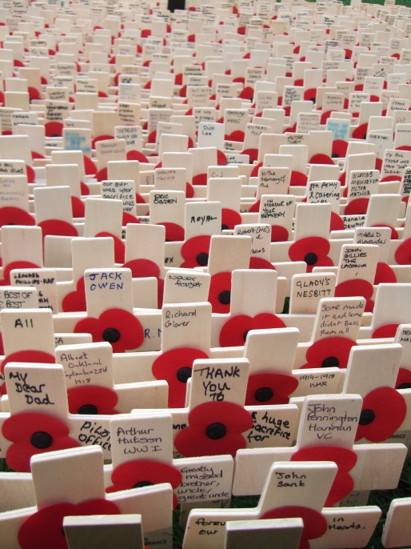
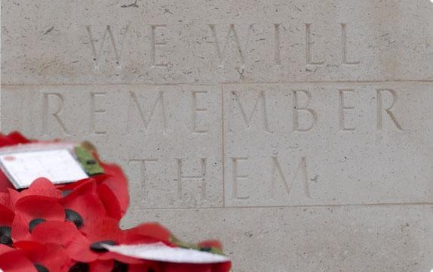
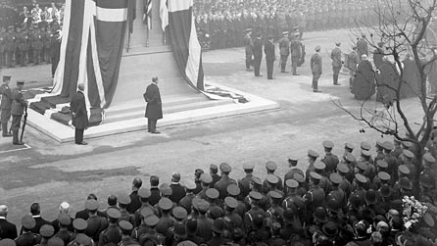
What happens on Remembrance Day?
What symbols can you see?
What are the people doing? Why?
What do the words mean?
Stone of Remembrance © Royal British Legion
Field of Remembrance © War Memorials Trust, 2011
Unveiling of the Cenotaph, London (WM2446) © IWM

Slide 9
In Flanders fields
In Flanders fields the poppies blow
Between the crosses, row on row,
That mark our place; and in the sky
The larks, still bravely singing, fly
Scarce heard amid the guns below.
We are the Dead. Short days ago
We lived, felt dawn, saw sunset glow,
Loved and were loved, and now we lie,
In Flanders fields.
Take up our quarrel with the foe:
To you from failing hands we throw
The torch; be yours to hold it high.
If ye break faith with us who die
We shall not sleep, though poppies grow
In Flanders fields.

Slide 10
For the fallen
They shall grow not old, as we that are left grow old,
Age shall not weary them nor the years condemn.
At the going down of the sun, and in the morning
We will remember them.

